Slide 1
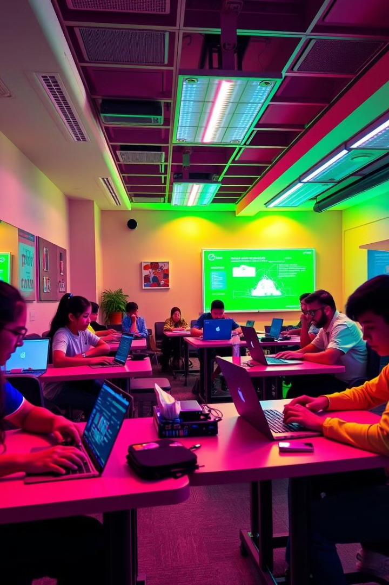

Decentralize Academy: Empowering Education
Welcome to Decentralize Academy, a revolutionary platform for online learning built on blockchain technology. We offer a unique and empowering learning experience by leveraging cutting-edge technologies to create a secure, transparent, and accessible educational ecosystem.
by Sangam Subedi

Slide 2
Leveraging React for Engaging User Interfaces
React's component-based architecture allows us to build dynamic and interactive user interfaces. The platform is designed to be intuitive and engaging, fostering an enjoyable learning experience for students.
User-Friendly
Responsive Design
Interactive Elements
Intuitive navigation, easy access to courses and materials.
Seamless experience on various devices, from desktops to mobile.
Engaging quizzes, discussions forums, and interactive exercises.

Slide 3
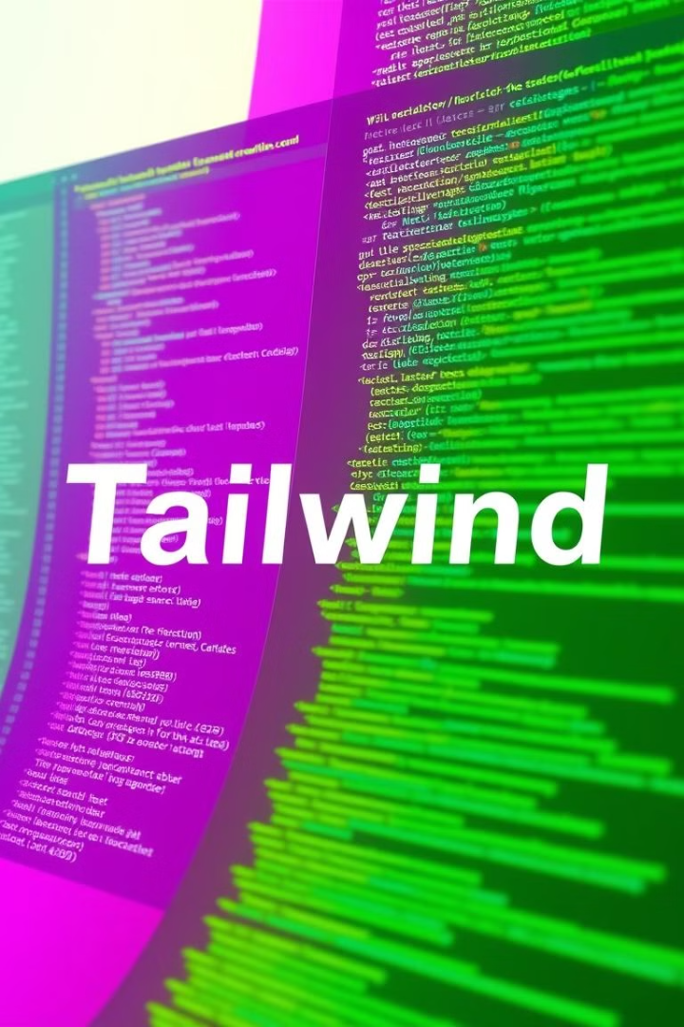
Tailwind CSS: Efficient Styling and Rapid Prototyping
Tailwind CSS's utility-first approach empowers us to create custom designs quickly and efficiently, reducing development time without sacrificing aesthetic appeal.
Rapid Prototyping
Consistent Styling
Quickly iterate and experiment with different designs.
Maintain a cohesive and professional look throughout the platform.
Customization
Tailor the platform's appearance to match the academy's branding.

Slide 4

Solidity: Powering Blockchain-based Courses
Solidity is the programming language we use to build smart contracts for our decentralized platform, ensuring secure and transparent interactions between students, instructors, and the blockchain.
1
Smart Contracts
2
Data Integrity
Automate course enrollment, assignment submissions, and reward distribution.
Protect student data and course materials from unauthorized access and tampering.
3
Transparency
Ensure a fair and verifiable learning environment for all participants.

Slide 5

Decentralized Course Delivery and Accessibility
Our platform allows for worldwide accessibility and flexible learning. Learners can access courses from anywhere at any time, removing geographical and logistical barriers to education.
1
Content Access
Students can access courses and learning materials from any location with an internet connection.
2
Flexible Learning
Students can learn at their own pace and schedule, making education accessible to those with busy lives.
3
Global Reach
Break down barriers and connect learners from around the world, fostering a diverse and inclusive community.

Slide 6

Secure and Transparent Student Records
Our blockchain-based system ensures the integrity and security of student records, eliminating the risk of data breaches or manipulation.
Decentralized
Centralized
Immutable and tamper-proof records
Vulnerable to data breaches and manipulation
Transparent and verifiable student achievements
Limited transparency and potential for fraud

Slide 7




Incentivizing Participation with Blockchain Rewards
By leveraging the power of blockchain technology, we can reward active participation and incentivize learning. Earn tokens for completing courses, participating in discussions, and contributing to the community.
Earn Tokens
Track Progress
Access Exclusive Benefits
Students receive tokens for completing courses, engaging in discussions, and contributing to the learning community.
Tokens can be used to track student progress and achievements transparently on the blockchain.
Holders of tokens can access exclusive benefits and opportunities within the platform, such as discounts on courses, early access to new content, or invitations to special events.

Slide 8




Collaborative Learning and Peer-to-Peer Interactions
Decentralize Academy fosters a vibrant community where students can connect, collaborate, and learn from each other.
Discussions
Students can engage in discussions, share knowledge, and ask questions.
Study Groups
Form study groups with peers to learn collaboratively and share resources.
Peer Review
Provide feedback on each other's work and learn from each other's strengths and weaknesses.

Slide 9
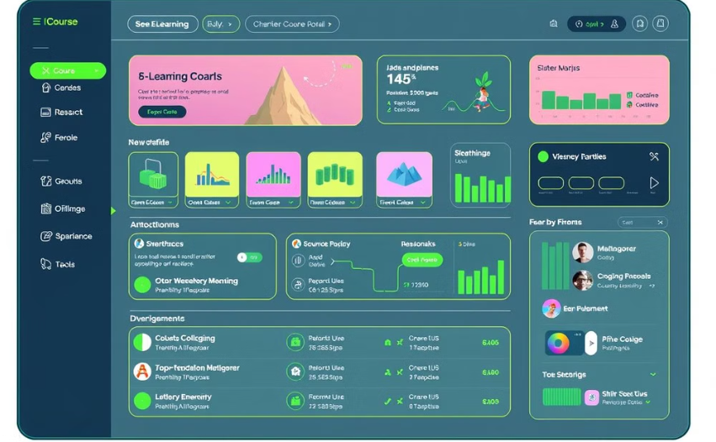

Scalable and Flexible Course Development
Our platform is designed to accommodate a growing number of courses and learners, ensuring a scalable and flexible learning environment.
Easy Course Creation
Scalable Platform
Instructors can easily create and upload courses using our intuitive platform, ensuring a seamless workflow.
Our platform can accommodate a growing number of courses and learners, ensuring a scalable and flexible learning environment.

Slide 10

Conclusion and Future Roadmap
Decentralize Academy is revolutionizing online education with its innovative blockchain-powered platform. We are committed to continuous improvement and development, with plans to integrate new features and functionalities, such as gamified learning, augmented reality, and decentralized governance.

